Slide 1

Online Localized Islamic Welfare System (OLIWS)
Supervisor : Mr . Rashid Ismail
Group Members:
Syeda Rida Fatima (Az461222)
Nida Khalid (BB479116)
Kaniz Fatima (AZ 461302)
Iram Kanwal (AZ461310)

Slide 2
Introduction
OLIWS is a platform through which we will raise funds in Islamic way . We will provide the service of “Education”, “Health” & “Loan” in localized area .Our project will be the source for those people who wants to help the needy and poor people. Companies and individual organizations are allowed to share their funds between each other when someone invited to for help , the invitee has the right to accept it or not . This is the quite easy way to help for those who wants to study , for those who wants live physically fit . It will also provide the platform to those who wants to be established in their life .

Slide 3
Problem Statement
According to different welfares those are totally manual . We have tried to convert this manual welfare into totally online Localized Islamic welfare system . In our society people have faced different problems , poverty has increased due to this , people are not able to afford their expenses and their education too . Through this Islamic welfare people will be able to fulfil wishes of their life .

Slide 4
Administration
The administration of something is the process of organizing and supervising it .
Admin is the one who will control all over the system .
Admin will check the profile of the user either it is a donor or receiver .
Admin will check the account details.
According to the definition of administration , all the data of a registered person , report of weekly , monthly & yearly will go to the admin .

Slide 5
Terms and Conditions
Donor/receiver have to follow our rules .
To be registered user have to be agreed our (OLIWS) terms and conditions .
After reading terms and condition if the user agree to get registered then he will click the agreed button .

Slide 6
Module
Registration:
All the users can be registered through signing up.
Sign Up:
To get registered in (OLIWS) user have to fulfil different requirements. User it may be a donor/receiver will have to fulfil some important requirements
to get in touch with our Online Localized Islamic Welfare System. For example these requirements can be name, father name, id card , phone number , email etc.

Slide 7
Module
Already Registered:
If the user is already registered then he/she has to be login .
Login:
To get login user have to fill up just two requirements , email id which is the user has given to get registered and the password which one user has set for his /her profile.
Profile :
User privacy
Private
public

Slide 8
Modules
Funds:
Fund is basically a main module . For example fund is just like zakat and sadaqah. Further it is divided into two sub modules.
Fund raising
Fund utilization
Fund Raising:
Fund raising will be the main part of our non-profit organization . Non-profits pay no income tax on the donation they receive or any money they earn through fund raising activities . Fund raising will be totally in Islamic way . Fund will be taken only from Muslims . It will be in form of Zakat and Sadaqah .

Slide 9
Module
Fund Utilization :
In this module we will utilize our funds in education, health and even for loan if anyone want it . Fund will be utilized according to sunnah (SAW) .Because Zakat and Sadaqah is only given to the Muslims that’s why Islamic welfare will totally work on Islamic based .Education facilities will be provided by giving scholarship .Health facilities will be given satisfactory and the third one is loan which will be totally interest free and will be given and taken in totally Islamic way.
Account :
User donor/receiver should have an account.
Account type:
Debit
Credit
Specified Period:
Funds accounts in a specified period . If the carried fund is not spent fully i.e make available for next period .

Slide 10
Module
Education:
In Education our welfare will provide the scholarship to those who want to register in any institute or want to pay fee or want to buy some stationary. This welfare will provide the scholarship to the orphan and special children even the deserving children who are not able to meet their education expenses.
Sub- Module:
Admission
Fee
Stationary

Slide 11
Module
Health:
The Patient should present their medical report as proof online. we will provide the needy person medicine, free treatment, and surgeries from our selective Local Hospital and Clinic.
Sub-Module
Medicine

Slide 12
Module
Loan:
We will provide totally interest free loan and didn’t have any hidden charges. The loan will be provided in three categories.
Loan will be provided after necessary procedure.
Return
The interest free instalment will be taken after one month

Slide 13
Module
Report:
Admin will check the weekly, Monthly and yearly report.
Expected Output:
The expected output from our (OLIWS) is that :
The deserving people will be able to get education.
Those people who are not able to get treatment from any private hospital or clinic ,through our online Islamic welfare system those people will get satisfied treatment.
After getting interest free loan deserving people will be established.

Slide 14
Module
Feed Back:
In feed back user have to tell us about our Islamic welfare that he/she like it or not ,or it is a beneficial for poor and needy people or not . The user should give us feed back according to our given categories in which he/she got help from our Islamic welfare system . For example if user get the good result in education then he/she will give us his/her suggestions that how can we make our Online Islamic welfare best more according to purely Islamic way . Next feed back will be according to health and loan that he/she got satisfactory help or not.

Slide 15
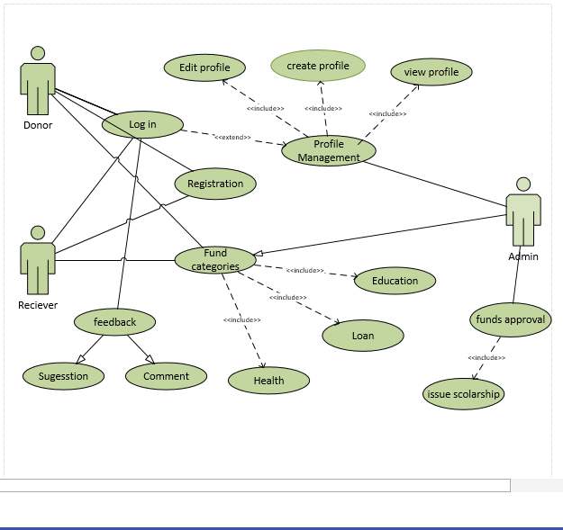
Use Case Diagram

Slide 16
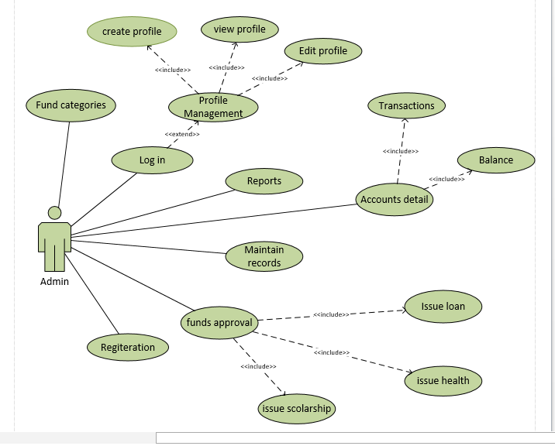
Use Case Diagram

